Slide 1




NEXT GEN EMPLOYABILITY PROGRAM
Creating a future-ready workforce
Team Members
College Name:
Arunachala College of Engineering for Women ,kanyakumari
Student Name : Abisha.C
Student ID : au960221104005

Slide 2

CAPSTONE PROJECT SHOWCASE
Project Title
Car Rentals Application with Django Framework
Abstract | Problem Statement | Project Overview | Proposed Solution | Technology Used | Modelling & Results | Conclusion

Slide 3
Abstract
In the dynamic landscape of modern transportation, efficient and user-friendly car rental platforms are essential for both customers and service providers. This abstract outlines the development of a comprehensive car rental application using the Django framework.
The primary objective of this application is to simplify the process of renting vehicles for users while providing robust management tools for administrators. Key features include user authentication, a intuitive booking interface, real-time availability tracking, payment integration, and administrative functionalities such as managing vehicle inventory, user accounts, and rental transactions.
Utilizing Django's built-in features such as its powerful ORM (Object-Relational Mapping) system, template engine, and authentication system, the application ensures scalability, security, and maintainability. Additionally, Django's emphasis on DRY (Don't Repeat Yourself) principle facilitates rapid development and code reuse.
The application follows a modular architecture, allowing for easy extension and customization. Frontend is implemented using HTML, CSS, and JavaScript, with Bootstrap for responsive design and enhanced user experience. Backend functionalities are powered by Django, leveraging its MVC (Model-View-Controller) pattern for clean separation of concerns.
Furthermore, the application integrates with external APIs for location services, payment processing, and vehicle data retrieval, enhancing its functionality and providing users with a seamless experience.
Overall, this Django-based car rental application aims to revolutionize the car rental industry by offering a modern, efficient, and user-centric platform for both customers and service providers alike.
Source :

Slide 4
Problem Statement
The car rental industry faces several challenges in delivering a seamless and efficient experience to customers. Traditional rental processes are often cumbersome, involving manual paperwork, limited vehicle availability visibility, and fragmented payment systems. Additionally, managing vehicle inventory and customer data manually can lead to inefficiencies and errors for rental businesses.
To address these challenges, there is a need for a comprehensive car rental application that streamlines the rental process for both customers and rental providers. This application should leverage modern technology to automate tasks, improve user experience, and enhance operational efficiency.
Source :

Slide 5
Project Overview
The "Streamlined Car Rentals" project aims to develop a comprehensive car rental application using the Django framework. The application will revolutionize the car rental industry by offering a modern, efficient, and user-centric platform for both customers and service providers alike.
Source :

Slide 6
Proposed Solution
Project Setup: Start by setting up a Django project.
bash
ddjango-admin startproject car_rental_project
App Creation: Create a Django app for the car rental functionality.
Bash
cd car_rental_project python manage.py startapp car_rental
Define Models: Define Django models to represent cars, customers, reservations, etc. Here's a basic example:
Python
# car_rental/models.py from django.db import models class Car(models.Model): make = models.CharField(max_length=50) model = models.CharField(max_length=50) year = models.IntegerField() # Add more fields as needed class Customer(models.Model): name = models.CharField(max_length=100) email = models.EmailField() # Add more fields as needed class Reservation(models.Model): car = models.ForeignKey(Car, on_delete=models.CASCADE) customer = models.ForeignKey(Customer, on_delete=models.CASCADE) pickup_date = models.DateField() return_date = models.DateField() # Add more fields as needed
Admin Interface: Register models with the Django admin for easy management.
Python
# car_rental/admin.py from django.contrib import admin from .models import Car, Customer, Reservation admin.site.register(Car) admin.site.register(Customer) admin.site.register(Reservation)
Views and Templates: Create views and templates for handling rental requests, reservations, etc. Use Django's built-in template language for rendering HTML templates.
Forms: Create Django forms for user input (e.g., rental requests, customer information).
Authentication and Authorization: Implement user authentication and authorization to manage access control.
URL Routing: Define URL patterns to map views to URLs.
Business Logic: Implement business logic for renting cars, checking availability, calculating prices, etc.
Testing: Write unit tests to ensure the application functions as expected.
Deployment: Deploy the application using platforms like Heroku, AWS, or Azure.
User Interface Enhancement: Enhance the user interface using frontend frameworks like Bootstrap or CSS libraries.
Payment Integration: Integrate payment gateways for handling transactions.
Error Handling and Logging: Implement error handling and logging to track issues and debug efficiently.
Performance Optimization: Optimize database queries, use caching, and implement other performance-enhancing techniques.
Documentation: Document the codebase, APIs, and deployment process for future reference.
.
Source :

Slide 7
Advanced User Authentication:
Implement role-based access control (RBAC) to differentiate between employees, managers, and administrators.
Integrate social login options for ease of access.
Interactive Dashboard:
Develop a dynamic dashboard for employees and managers to view real-time analytics, including rental statistics, revenue, customer feedback, and inventory status.
Use Django's built-in admin interface for managerial tasks and reporting.
Employee Training Module:
Create a dedicated section for employee training modules covering topics such as customer service, vehicle knowledge, safety procedures, and conflict resolution.
Utilize Django's content management system (CMS) or integrate a learning management system (LMS) for organizing and delivering training content.
Skill Assessment and Certification:
Implement skill assessment quizzes or exams within the training module to evaluate employees' knowledge and proficiency.
Award digital certificates or badges upon completion of training modules and achieving proficiency levels.
Gamification Elements:
Introduce gamification elements such as points, badges, leaderboards, and challenges to incentivize employee engagement and skill development.
Encourage healthy competition among employees by recognizing top performers.
Source :

Slide 8
Feedback and Performance Tracking:
Incorporate a feedback mechanism allowing customers to rate their rental experience and provide comments.
Enable managers to track employee performance, review customer feedback, and provide constructive feedback or rewards.
Predictive Analytics:
Use machine learning algorithms to analyze historical data and predict demand for specific vehicle types during different seasons or events.
Optimize inventory management and pricing strategies based on predictive analytics insights.
Mobile Application:
Develop a mobile application for both customers and employees, enabling easy booking, vehicle check-in/check-out, and communication.
Ensure seamless synchronization between the web and mobile platforms.
Integration with External Services:
Integrate with mapping services for GPS navigation and route optimization.
Incorporate payment gateways for secure online transactions.
Connect with vehicle maintenance services for scheduling and tracking maintenance tasks.
Continuous Improvement:
Gather feedback from employees and customers regularly to identify areas for improvement.
Iterate on the application based on feedback and market trends to stay competitive and meet evolving needs.
Source :

Slide 9


Technology Used
Front-end
Back-end
Source :

Slide 10
Modelling & Results
The application can improve efficiency by automating car search, booking, and rental management processes . A well-designed interface can attract and retain customers with a user-friendly experience . Online booking reduces manual workload for staff and allows for faster processing of rentals . The admin panel provides centralized control over car information, user accounts, and rental data . A car rental application built with Django can create a user-friendly platform for customers and improve operational efficiency for the business.
Source :

Slide 11
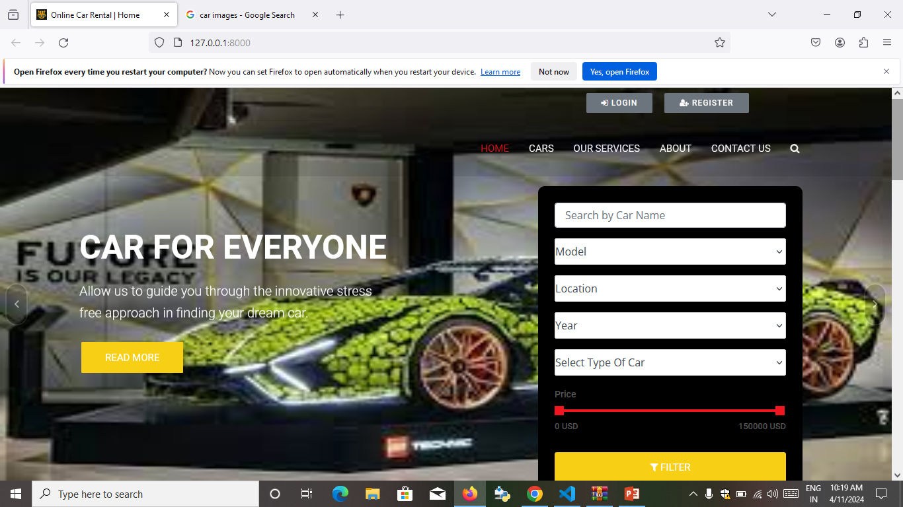
Homepage

Slide 12
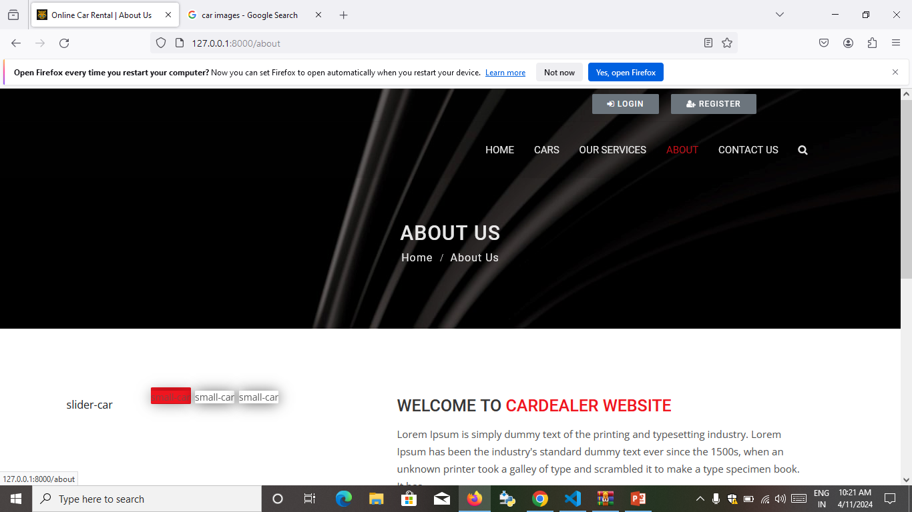
About-Us-Page

Slide 13
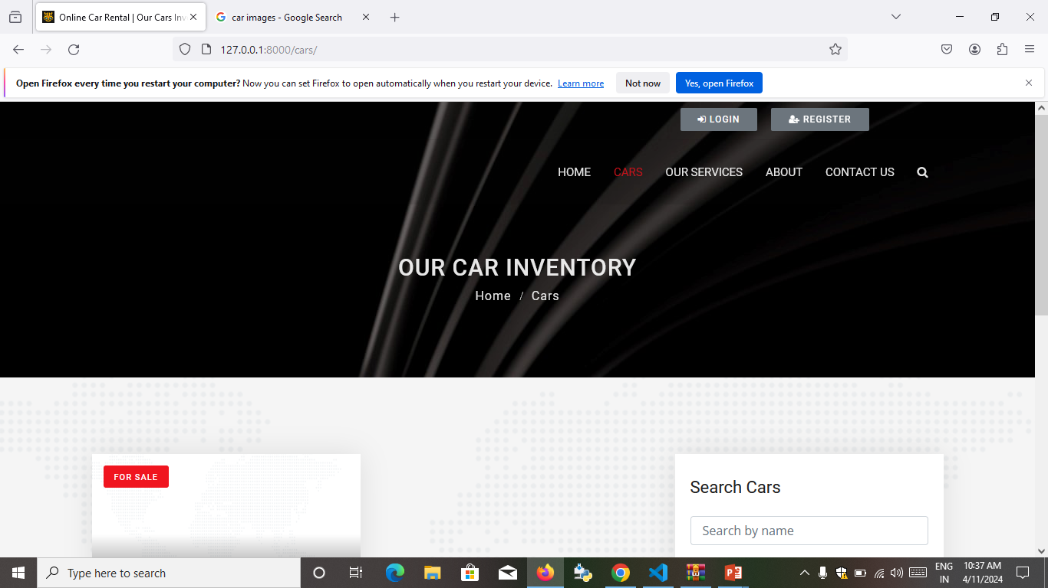
cars- page

Slide 14
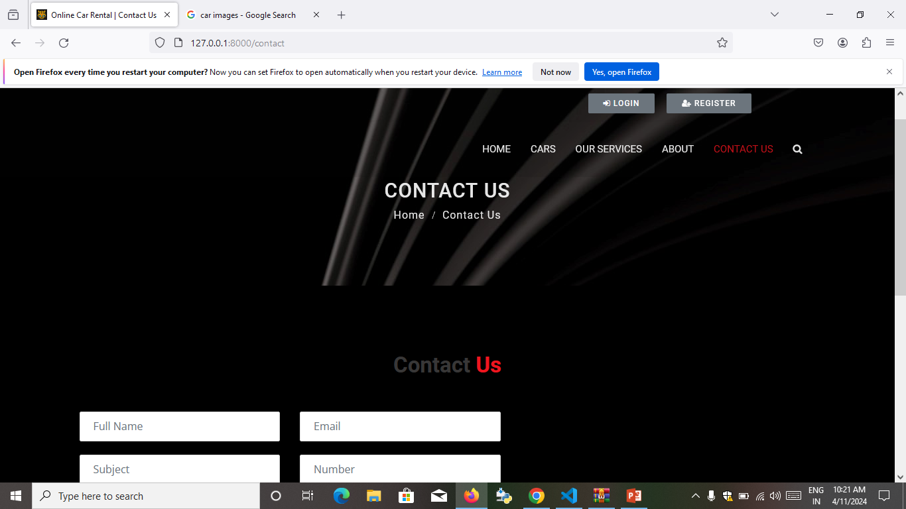
Contact us-page

Slide 15
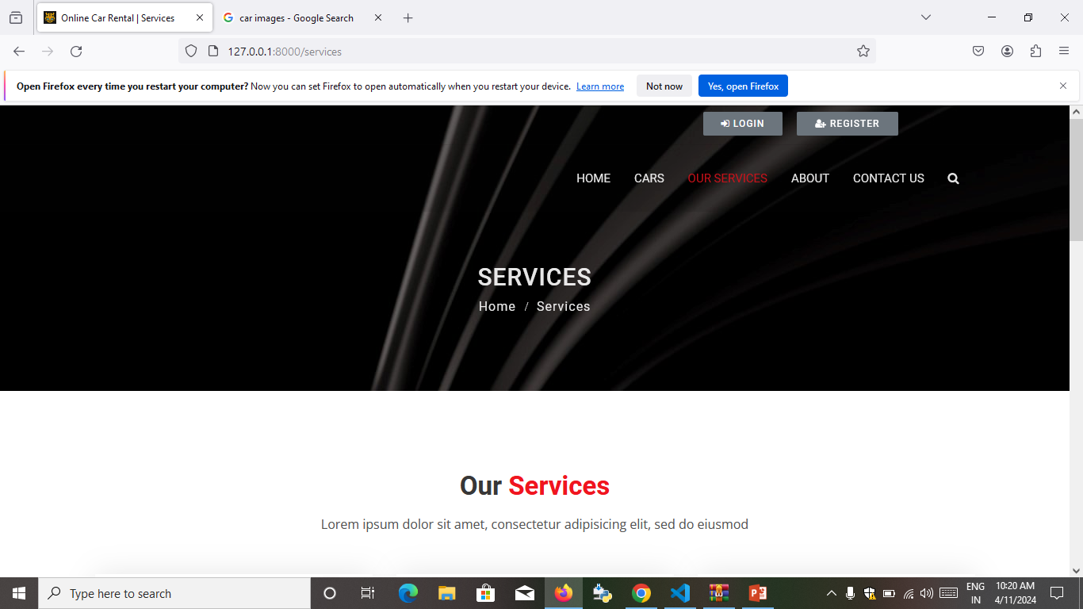
Service-Page

Slide 16
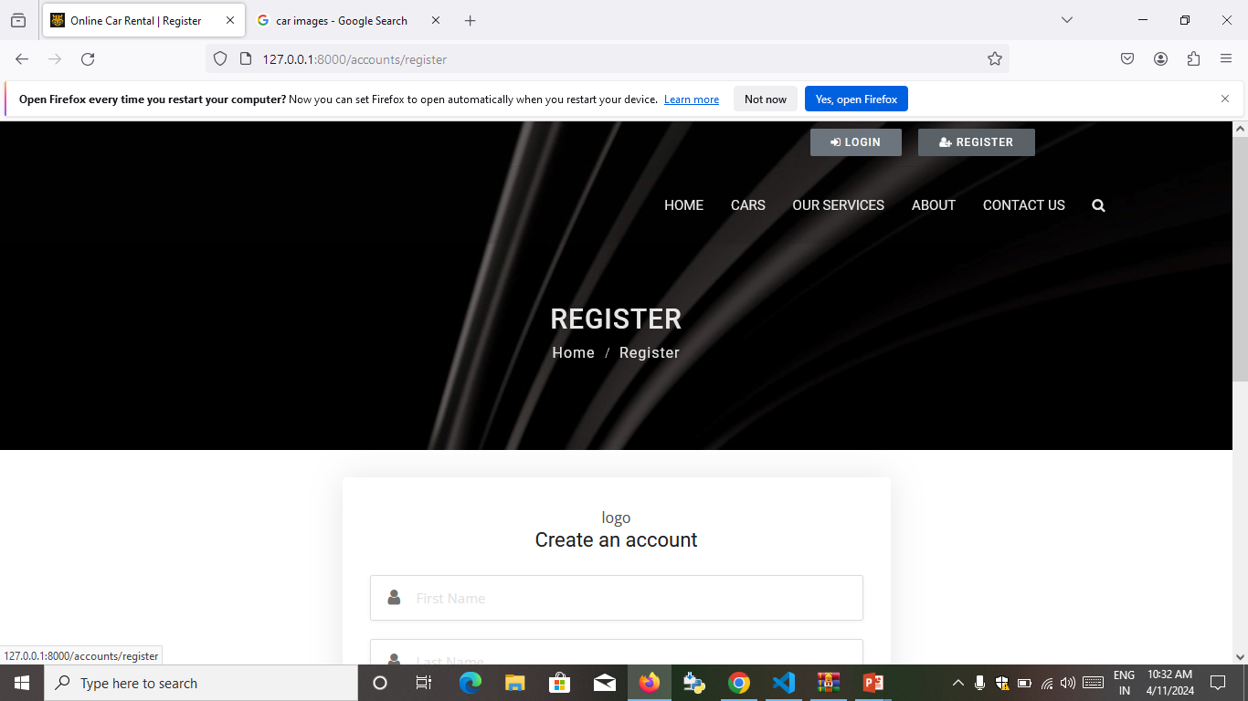
registration-Page

Slide 17
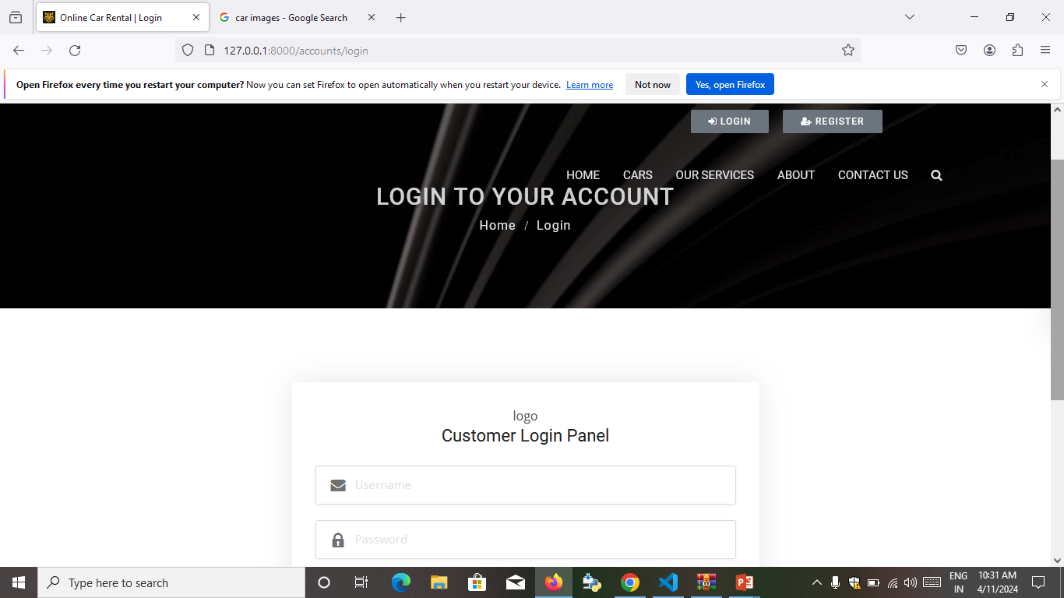
login-Page

Slide 18
Future Enhancements:
Payment gateway integration: Integrate with popular payment gateways like Stripe or PayPal for secure online payments . Automatic insurance options: Offer users the option to purchase rental car insurance during the booking process, potentially integrating with insurance providers . Paperless rentals: Implement a system for digital contracts and electronic signatures .Integrate with telematics systems to track car location, fuel levels, and potential maintenance needs.

Slide 19
Conclusion
Users can conveniently search for available cars based on various criteria, simplifying the car selection process . A clear calendar view helps users visualize car availability for their desired rental period . The admin panel provides centralized control over car information, user accounts, and rental data . We can create a comprehensive car rental application that delivers a positive experience for both users and the business.
Source :

Slide 20
Thank You!
Notes:
Thank You !!

